Slide 1
Fog Computing
Lihui, Huang
2017/10/08

Slide 2

Haze Computing ???

Slide 3

OpenFog Consortium
On November 19, 2015, Cisco Systems, ARM Holdings, Dell, Intel, Microsoft, and Princeton University, founded the OpenFog Consortium, to promote interests and development in fog computing.

Slide 4
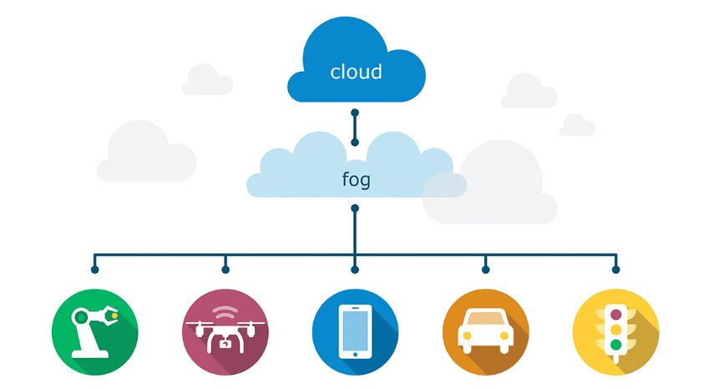
Fog vs. Cloud

Slide 5
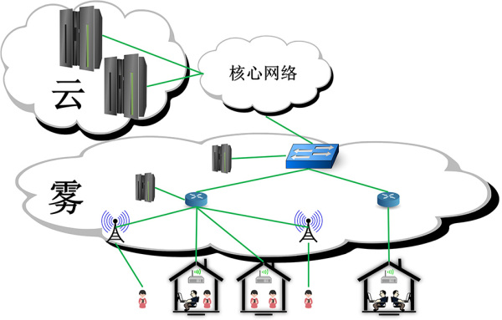
Fog computing

Slide 6
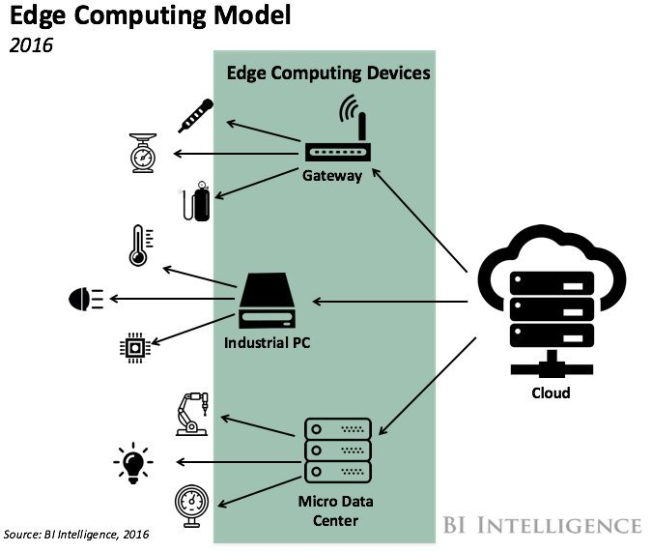
Fog Computing Model

Slide 7
What’s fog computing ?
Fog computing is a system-level horizontal architecture that distributes resources and services of computing, storage, control and networking anywhere along the continuum from Cloud to Ground.

Slide 8
We need Fog Computing!
Many Internet of Things deployments face challenges related to latency, network bandwidth, reliability and security, which cannot be addressed in cloud-only models.
Fog computing adds a hierarchy of elements between the cloud and endpoint devices. So It has a bigger proximity to end-users and bigger geographical distribution.

Slide 9
What’s the applications?
The applications can include industrial automation, transportation and networks of sensors. Other uses include:
Smart Grid
Smart Traffic Lights
Wireless Sensor and Actuator Networks
Decentralized Smart Building Control

Slide 10
Smart Traffic Lights
It will change the lights to open lane under the observation of the traffic and pedestrians.
Secure and Privacy-Preserving Data Forwarding in VANETS: A Social Behavior Based Approach
RSU : Road Side Unit

Slide 11
Decentralized Smart Building Control
Wireless sensors help measure temperature, humidity and gas levels in a building, and such information is exchanged among all sensors in order to form reliable measurements.
Fog devices and sensors will react to the data and take decisions such as lowering the temperature or removing moisture from the air, creating smart buildings.

Slide 12

Welcome TO THE FOG COMPUTING ERA !!!

